Slide 1
The results of baseline test for 2013 HWRF implementation
Young Kwon, Vijay Tallaparagada and HWRF team

Slide 2
2013 HWRF pre-implementation test plan
 | Baseline (H130) | Physics upgrades |  |  |  | Combined (H213)
 |  | PBL(H131) | Meso-SAS (H132) | RRTMG (H133) | Ocean (H135) | Final configuration
Description | Revised init/GSI, New nest parent interpolations, Radiation bug fix, Revised nest movement, Increased frequency of Physics calls | Variable Ric | Meso SAS | Radiation | MPI-POM | Baseline+ physics
Person | Qingu, In-Hyuk Sam Trahan Mingjing, Young | Young/Weiguo | Qingfu | Chanh | Biju Thomas (URI) | All
Cases | Whole 2011 and 2012 storms and some 2010 storms | Priority cases | Whole 2011 and 2012 storms and some 2010 storms | Priority cases | Whole 2011 and 2012 storms and some 2010 storms | Whole 2011 and 2012 storms and some 2010 storms

Slide 3
2013 HWRF baseline configurations
1. Vortex initialization
- Storm size correction – R34 and RMW
- Hurricane filter domain is revised (smaller than that of H212)
- Cold start use GFS vortex if a storm is weaker than 16m/s
2. Hybrid DA
- First guess is from GDAS 3, 6 and 9 hour forecast after vortex relocation
- Data assimilation on outer domain only followed by vortex initialization
- GSI hybrid analysis using global EnKF forecast ensemble
- 80 members of global ensemble members are given 75% weight to
background error covariance
- GSI hybrid analysis using global EnKF forecast ensemble

Slide 4
2013 HWRF baseline configurations
3. Infrastructure and bug fixes
- Change the preprocessors (prep_hybrid) for WP, resolution, vertical
interpolation
- Lager innermost domain with more frequent physics calling time step
- The vortex initialization codes are generalized for all basins (unibasin)
- POM: removal of flux truncation
- Upgrade SW corner computation
- Bug fix: GWD subgrid scale terrain, increase of ptsgm in WP, 10m wind
conversion(post)
- Update the nest-parent interpolation and nest motion algorithm
(similar to Tim’s tracker algorithm)
- MP physics feedback

Slide 5
2010-2013
total verification statistics

Slide 6
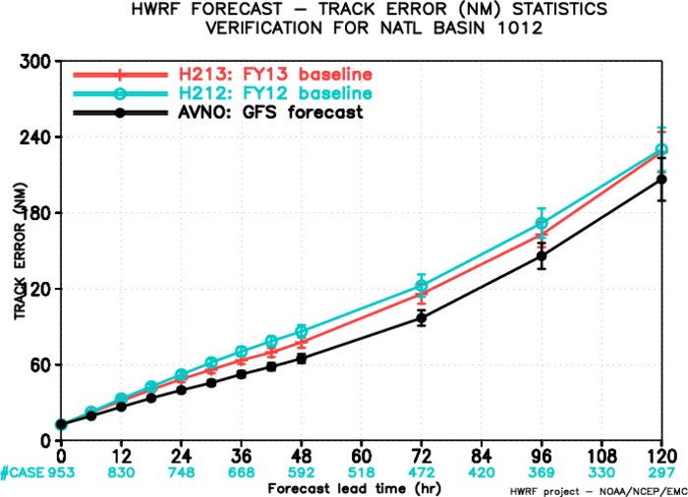
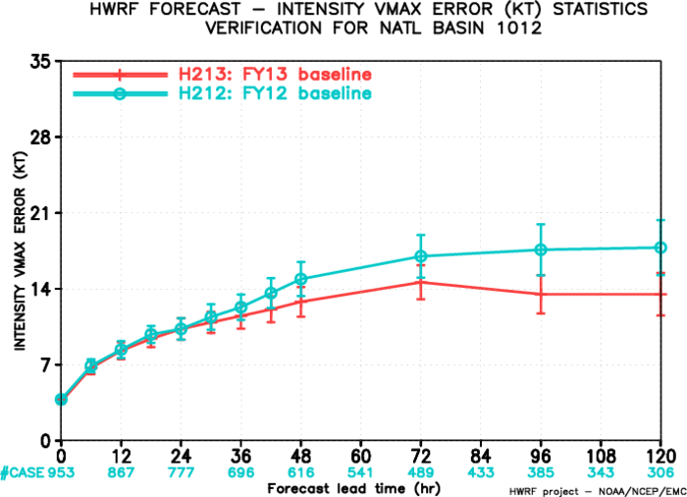
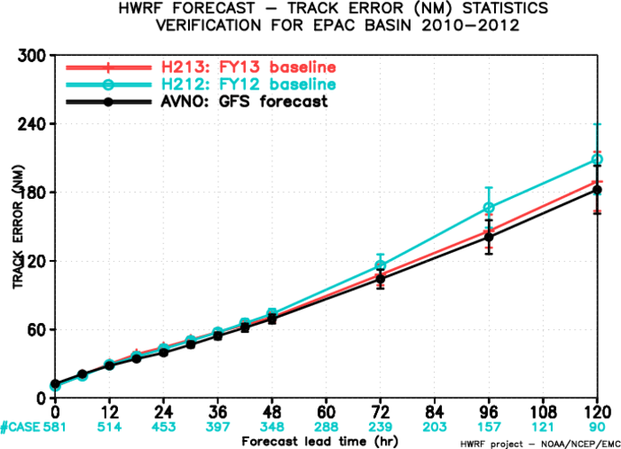
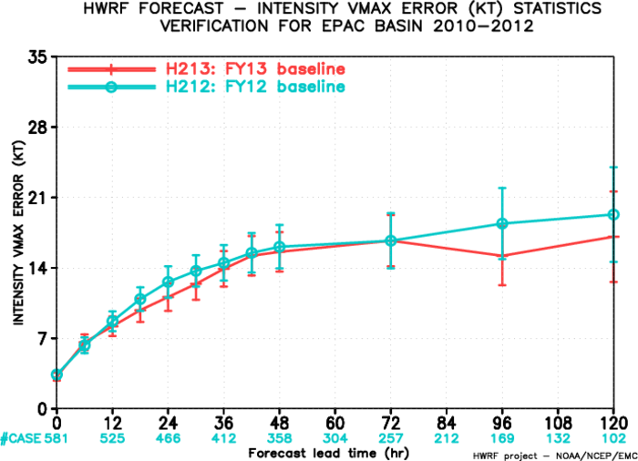
ATL track
ATL intensity
~8%
~25%
H212 (2012 HWRF)
H213 (2013 baseline)
EP track
EP intensity
~15%
~30%

Slide 7
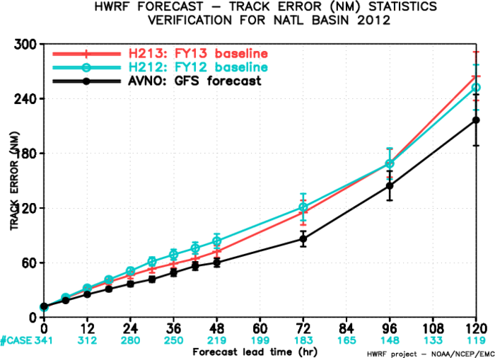
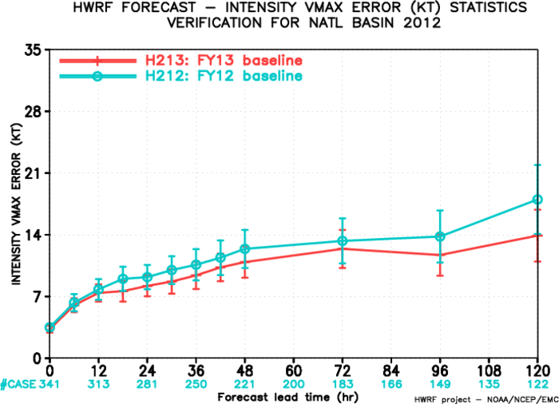
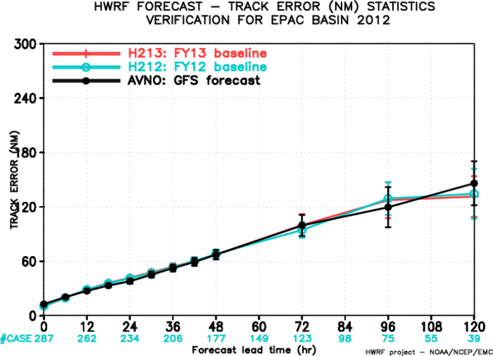
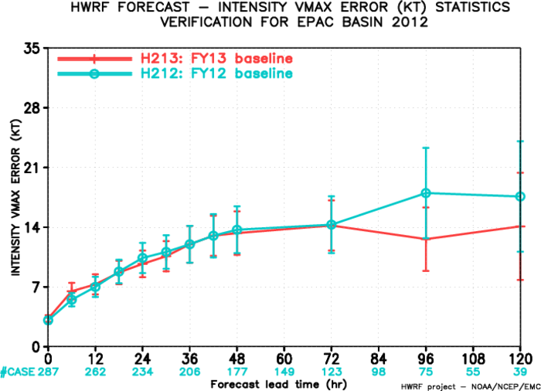
2012 season
ATL track
ATL intensity
~15%
~30%
H212 (2012 HWRF)
H213 (2013 baseline)
EP track
EP intensity
~20%

Slide 8
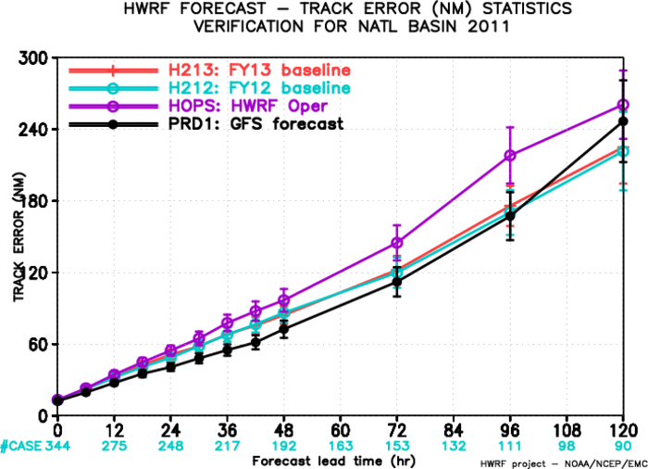
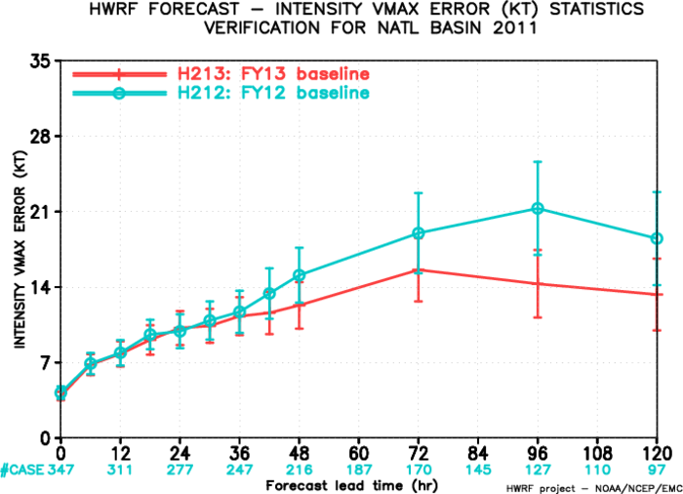
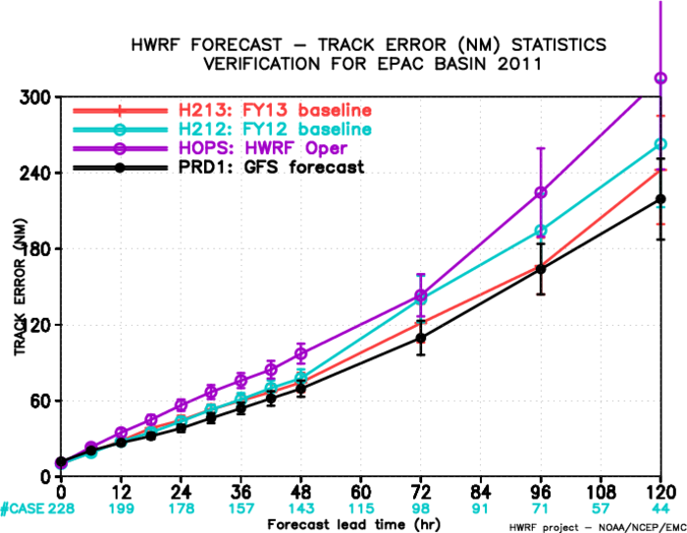
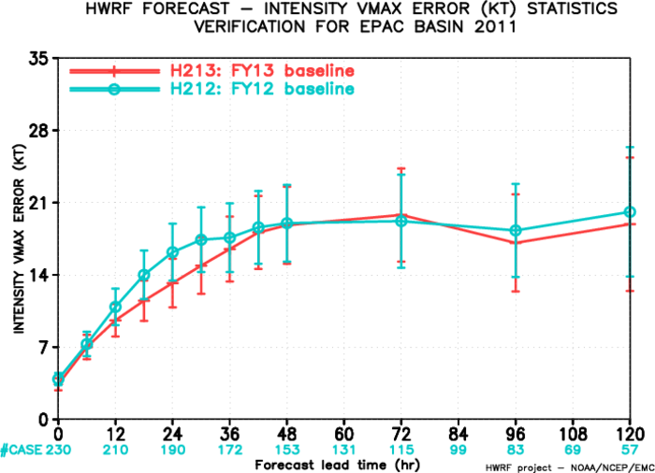
2011 season
ATL intensity
ATL track
~30%
H212 (2012 HWRF)
H213 (2013 baseline)
EP track
EP intensity
~12%
~20%

Slide 9
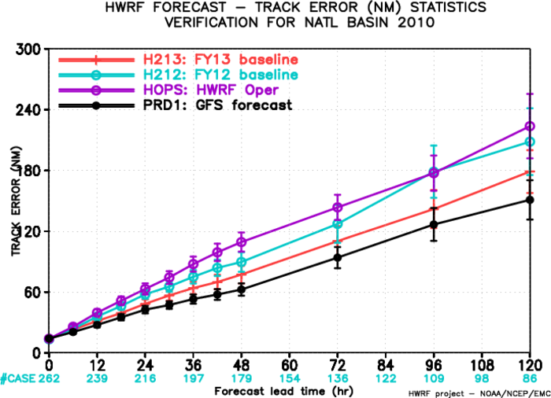
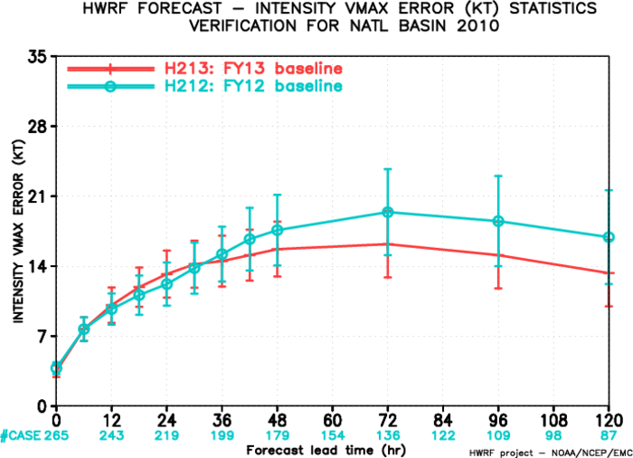
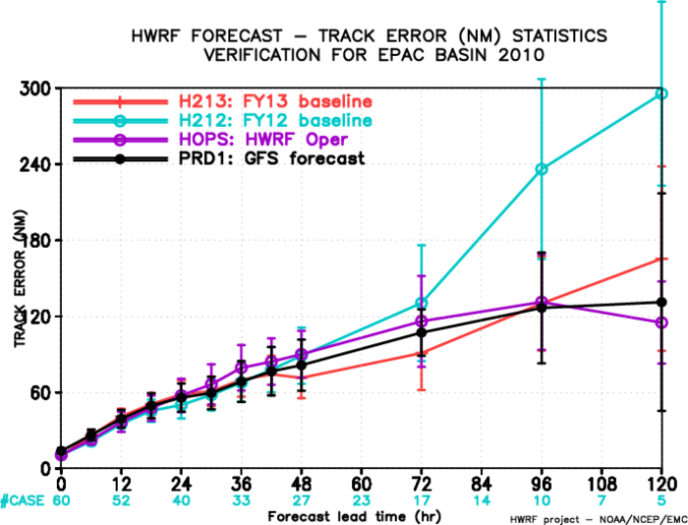
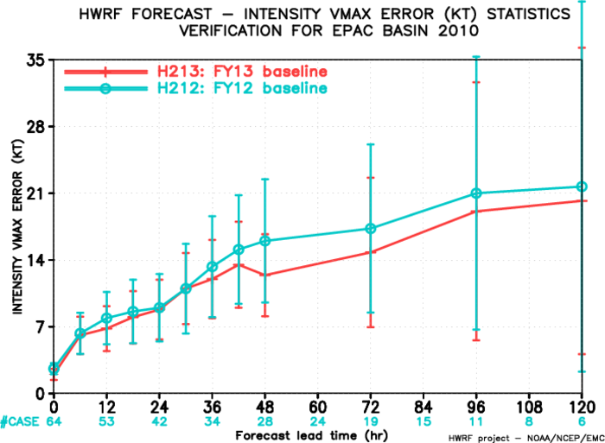
2010 season
ATL track
ATL intensity
~20%
~20%
H212 (2012 HWRF)
H213 (2013 baseline)
EP track
EP intensity
~48%
~20%

Slide 10
Individual storms

Slide 11
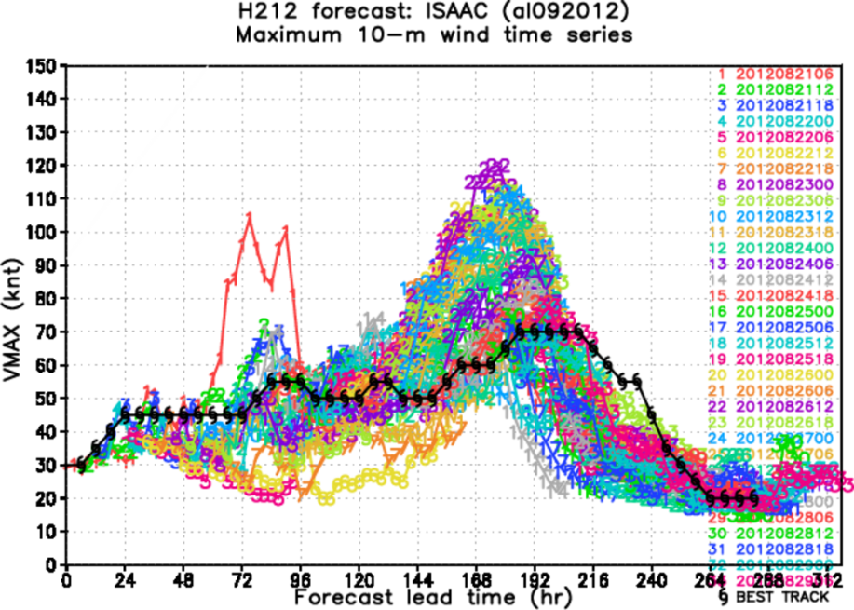
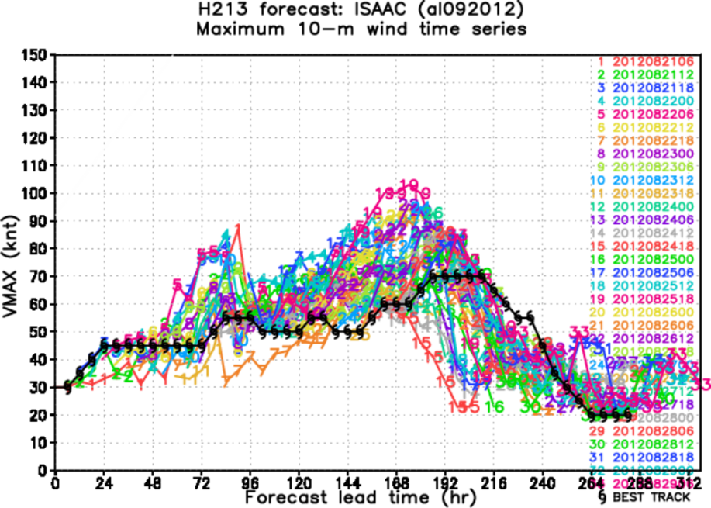
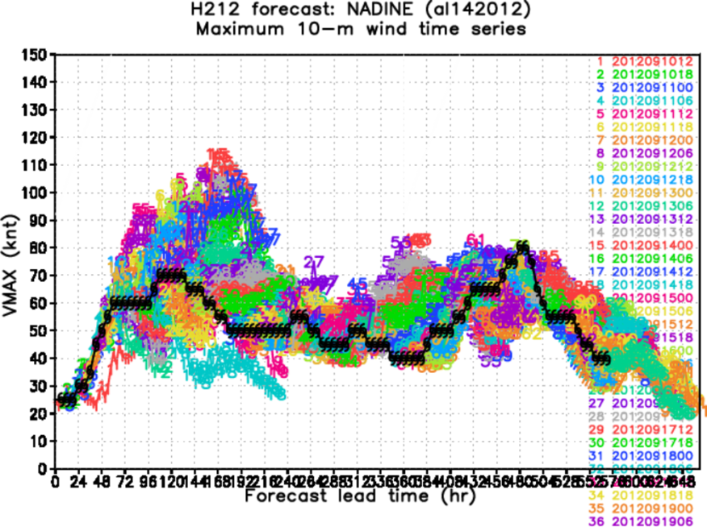
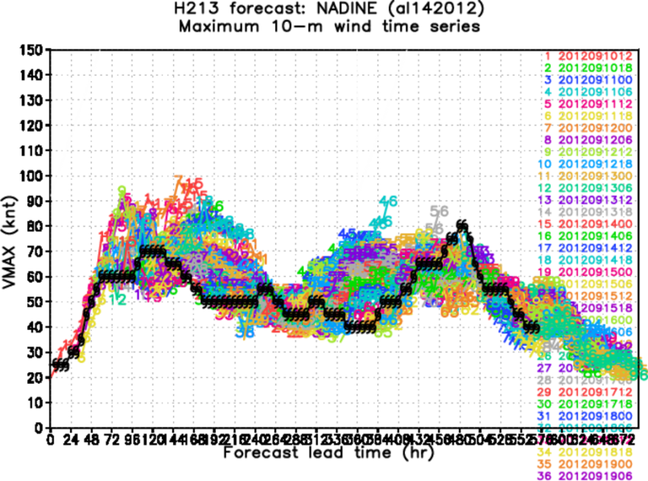
H212 H213
ISAAC
NADINE

Slide 12
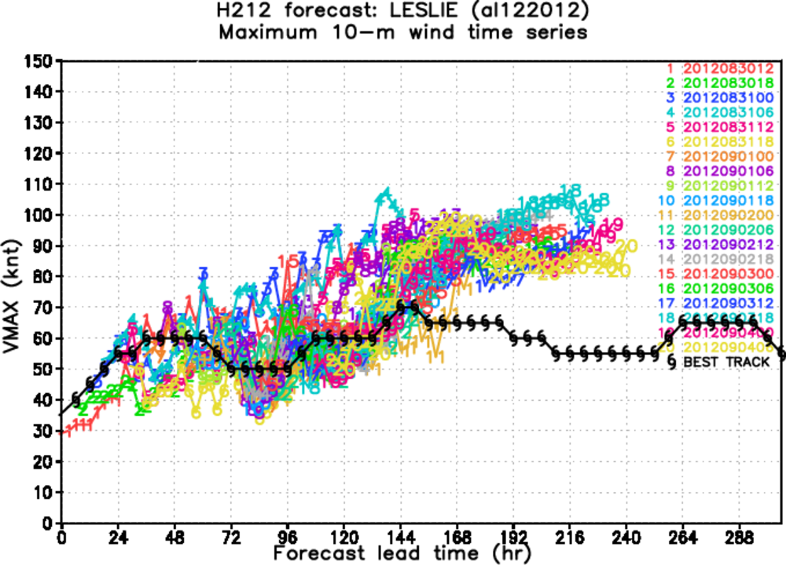
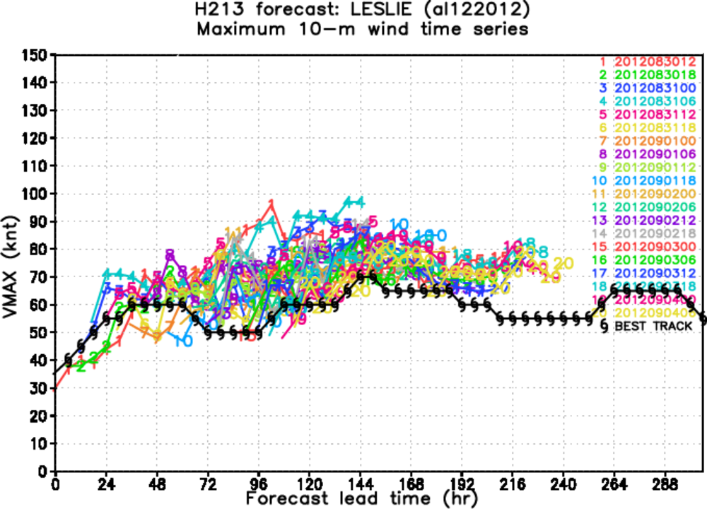
H212 H213
LESLIE
2013 HWRF baseline: http://www.emc.ncep.noaa.gov/gc_wmb/vxt/baseline/

